Slide 1
Sensory Exploration of Mass Spectrometry Data
Magnus Palmblad
Center for Proteomics and Metabolomics
Leiden University Medical Center

Slide 2
Disclaimers
The subject may have little practical relevance
The subject may not be of interest to anybody
I am not an expert on the subject

Slide 3





Lacunae?
visualize, visualization
audialize, audialization (auditize, auditization)
“to represent in auditory terms; to image in sounds”
tactilize, tactilization (haptic or kinesthetic comm.)
?
? (single Google hit for ”gustalization”)

Slide 4
Vision

Slide 5
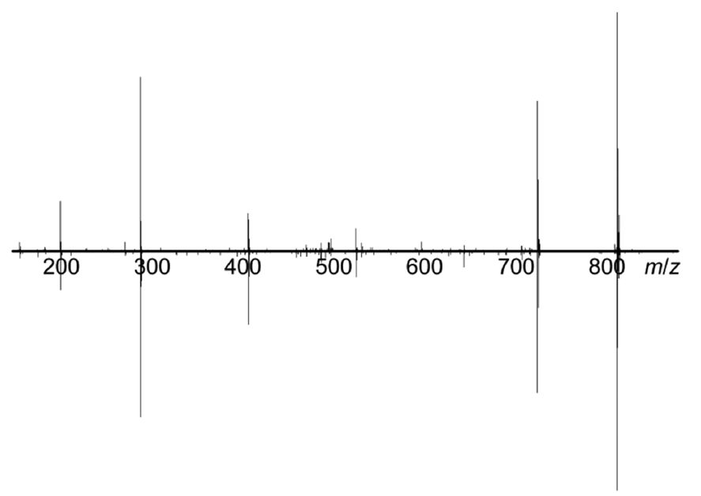
Vision

Slide 6
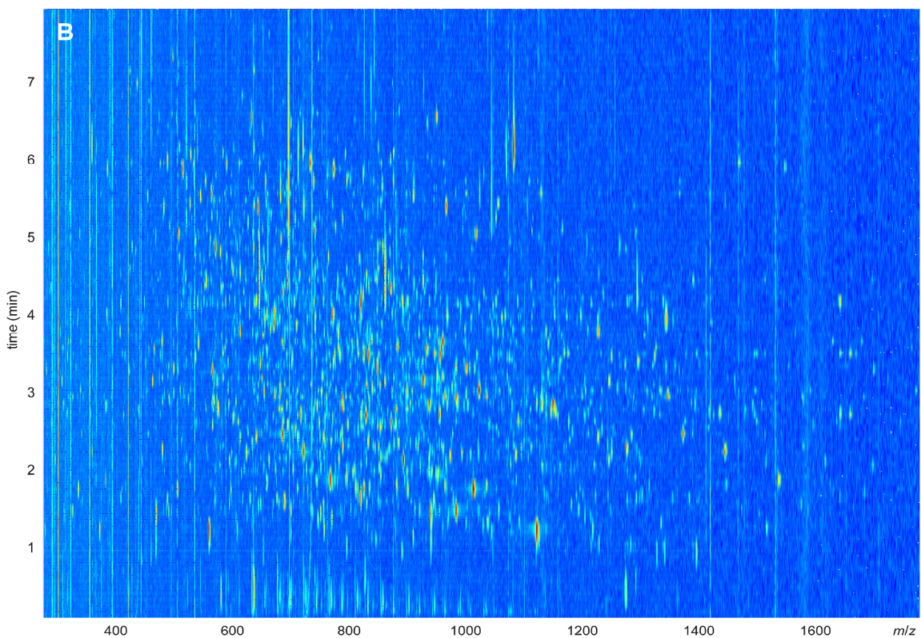
Vision

Slide 7
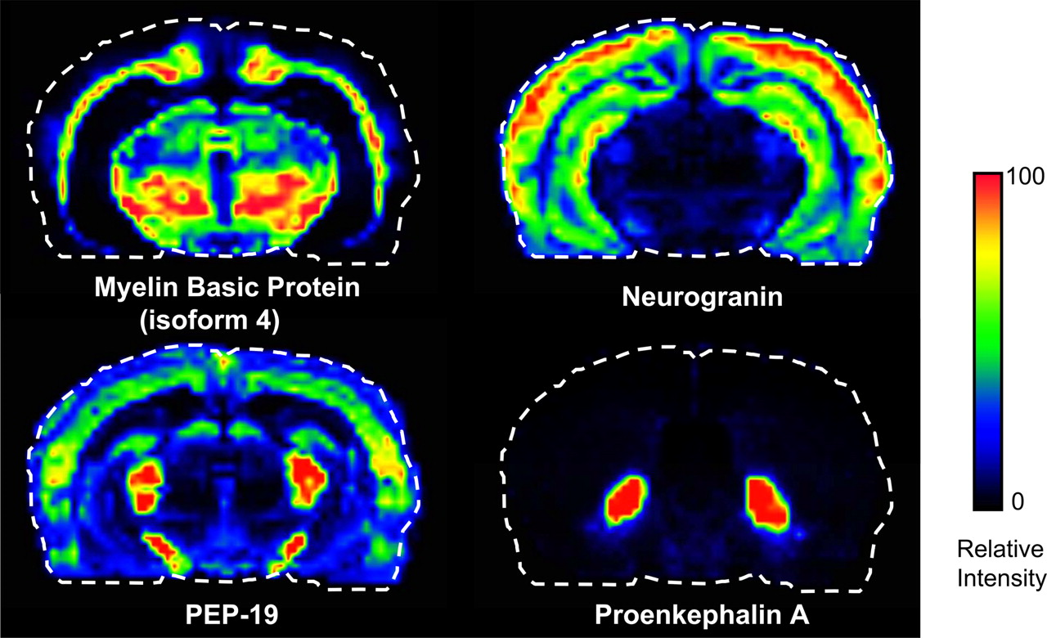
Vision
Seeley and Caprioli 2008

Slide 8
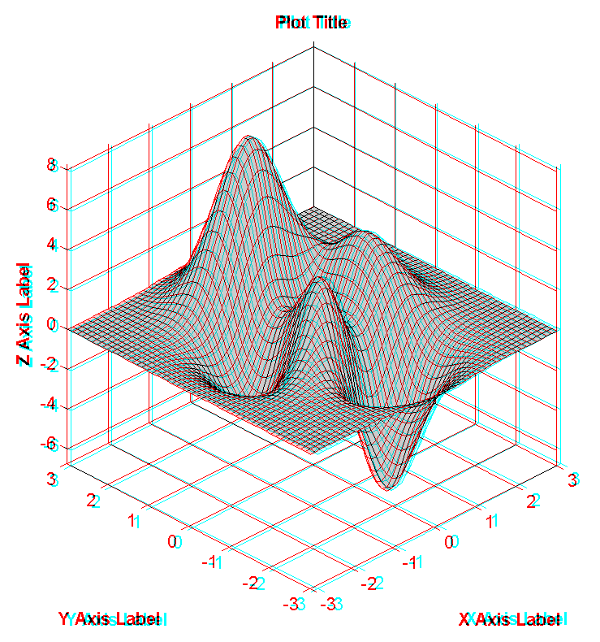
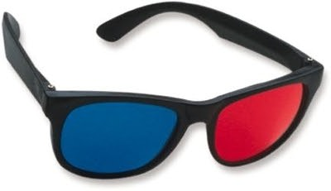
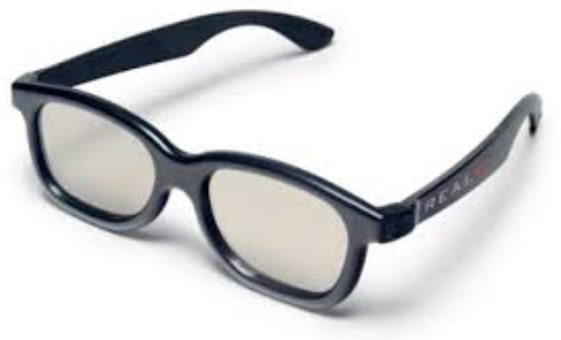
Vision – 3D

Slide 10
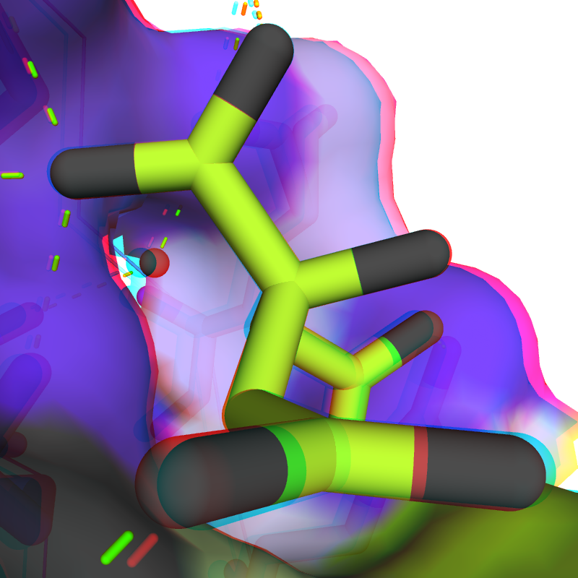
Vision – 3D
Notes:
From PyMOL's optimized anaglyph

Slide 11
Vision - summary
How we usually perceive mass spectra
3D displays:
Market pull: CAD, structural biology
Technology push: entertainment industry
Multidimensional data ’cool’ to view in 3D?
MATLAB and R can already generate 3D plots

Slide 12

Touch (mechanoreception)

Slide 13
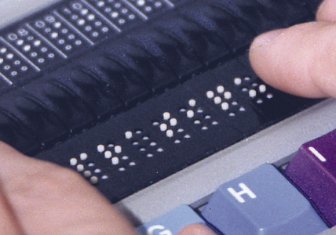
Touch – Braille monitor

Slide 14
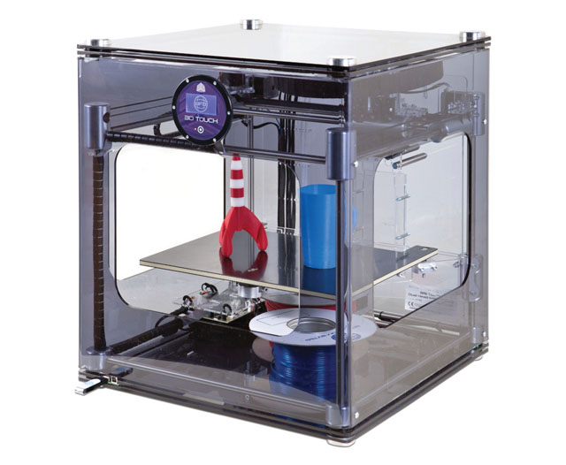
Touch – 3D printer

Slide 15
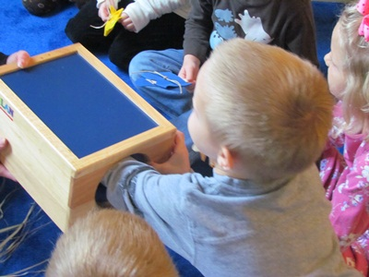
Feely boxes

Slide 16

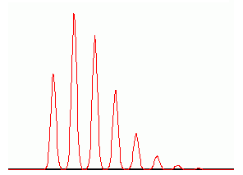
Touch (mechanoreception)
Pass around the feely box!
Can you feel the resolving power?
What about the chromatography?
Have a guess at the mass of the peptide!
As a control, guess also the mass of the peptide with this isotopic distribution:
Ctrl:
Dag Stuhl
Box: 12345
Ctrl: 9876

Slide 17

Hearing (audition)
Many ways to auditize/audialize MS data:
Mass spectra are numerical vectors
Any numerical vector can be audialized
ICR or Orbitrap transients can also be made into sound (best if modulated from kHz to Hz)
seewave (R package) or audiowrite (MATLAB)

Slide 18

Hearing (audition)
1/7 = 0.142857142857142857142857142857…
9
8
7
6
5
4
3
2
1
0
> a<-strsplit(as.character(bc('1/7', scale=10000)), split='');
> b<-as.numeric(unlist(a));
> b[1]<-0;
> savewav(b, f=2048);

Slide 19
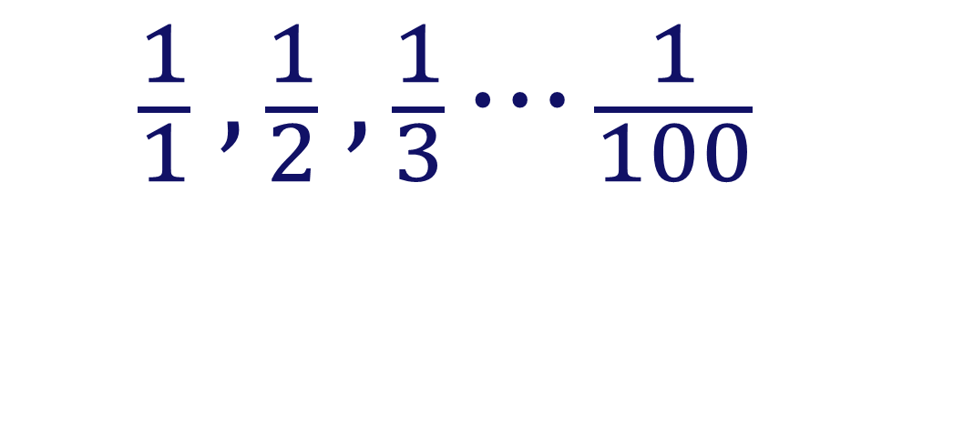
Hearing (audition)
$$\frac{1}{1} , \frac{1}{2} , \frac{1}{3}⋯\frac{1}{100}$$
for (i in 1:100) {
frac<-paste('1/',toString(i));
a<-c(a, strsplit(as.character(bc(frac, scale=300)), split=''))
}
b<-as.numeric(unlist(a));
b[is.na(b)]<-0;
b[1]<-0;
savewav(b, f=2048);

Slide 20

Hearing (audition)
$$π$$
for (i in 1:100) {
frac<-paste('1/',toString(i));
a<-c(a, strsplit(as.character(bc(frac, scale=300)), split=''))
}
b<-as.numeric(unlist(a));
b[is.na(b)]<-0;
b[1]<-0;
savewav(b, f=2048);

Slide 21
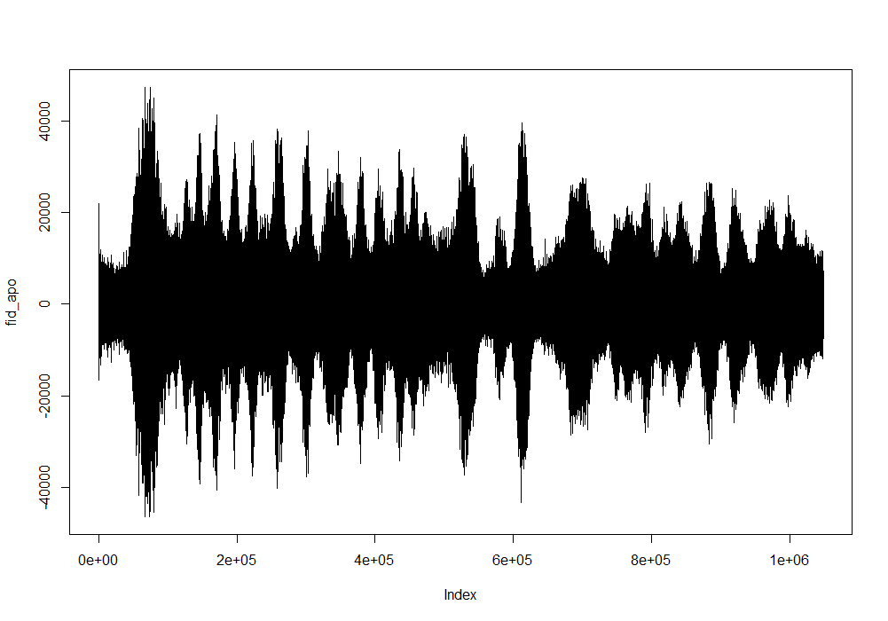
Hearing (audition)
> to.read=file("20140728_ApoCIII_1to10_000001.d/fid", "rb");
> fid_apo<-readBin(to.read, integer(), n=2^20, size=4, endian="little");
> plot(fid_apo, type="l");
> savewav(fid_apo, f=4092);
> close(to.read);

Slide 22
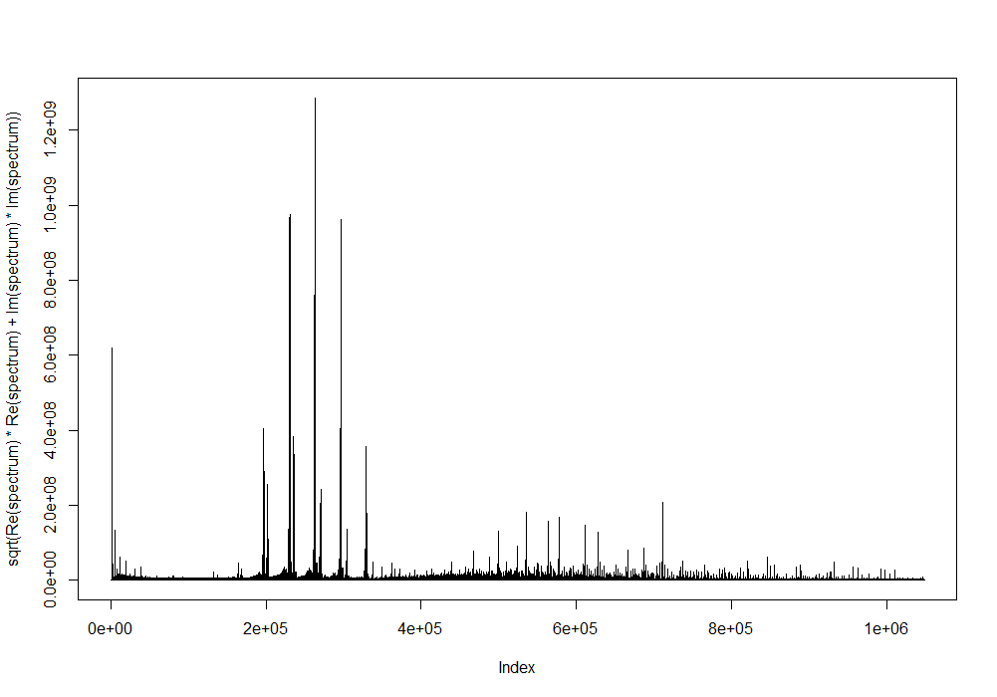
Hearing (audition)
> to.read=file("20140728_ApoCIII_1to10_000001.d/fid", "rb");
> fid_apo<-readBin(to.read, integer(), n=2^20, size=4, endian="little");
> plot(fid_apo, type="l");
> savewav(fid_apo, f=4092);
> close(to.read);

Slide 23
Hearing (audition)
> to.read=file("20140728_ApoCIII_1to10_000001.d/fid", "rb");
> fid_apo<-readBin(to.read, integer(), n=2^20, size=4, endian="little");
> plot(fid_apo, type="l");
> savewav(fid_apo, f=4092);
> close(to.read);

Slide 24

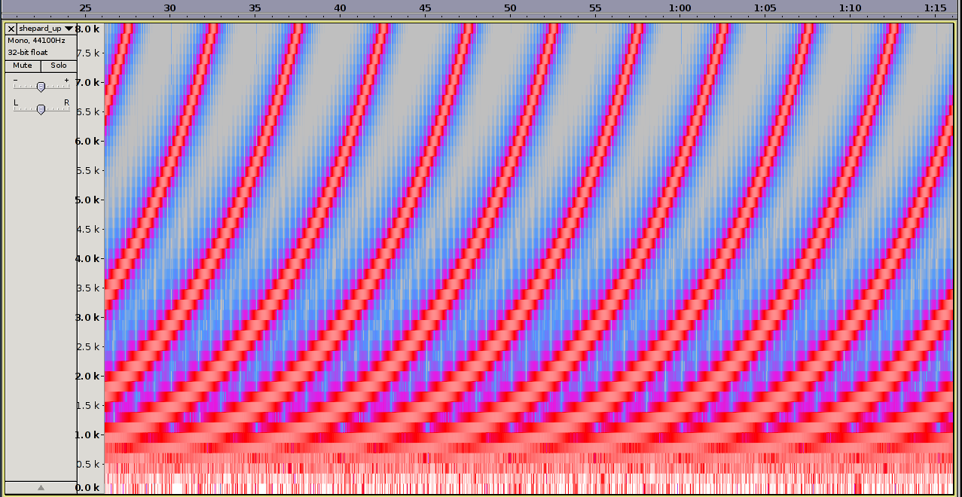
Shepard tone (barber's pole)

Slide 25
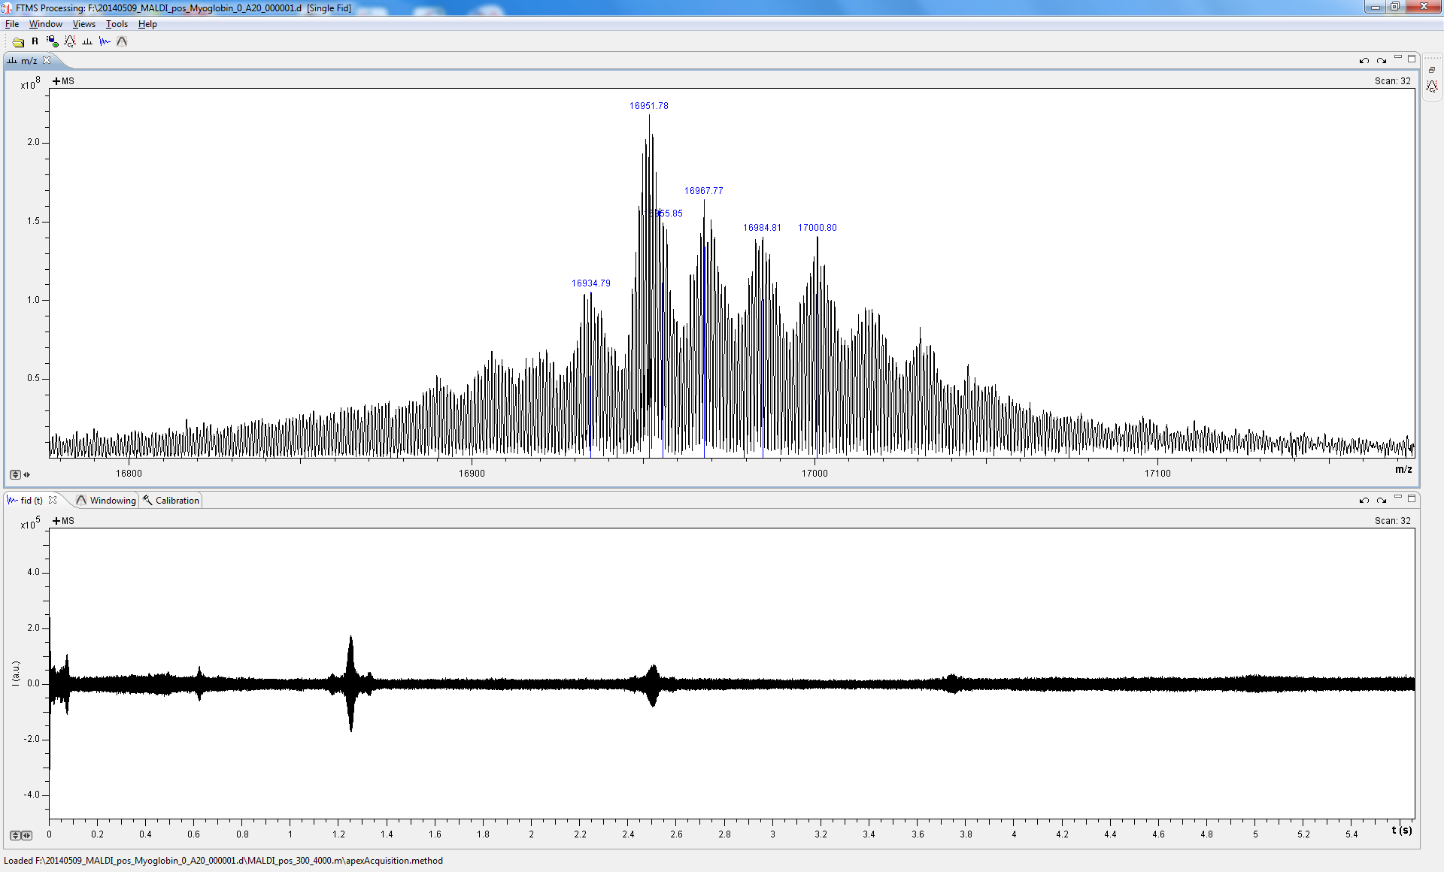
Hearing (audition)

Slide 26
Smell (olfaction)

Slide 27
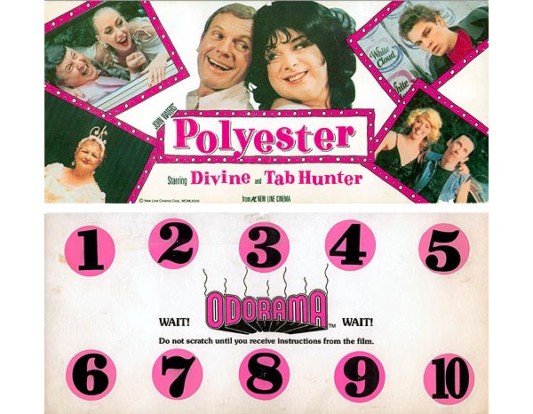
Smell – Smell-O-Vision

Slide 28
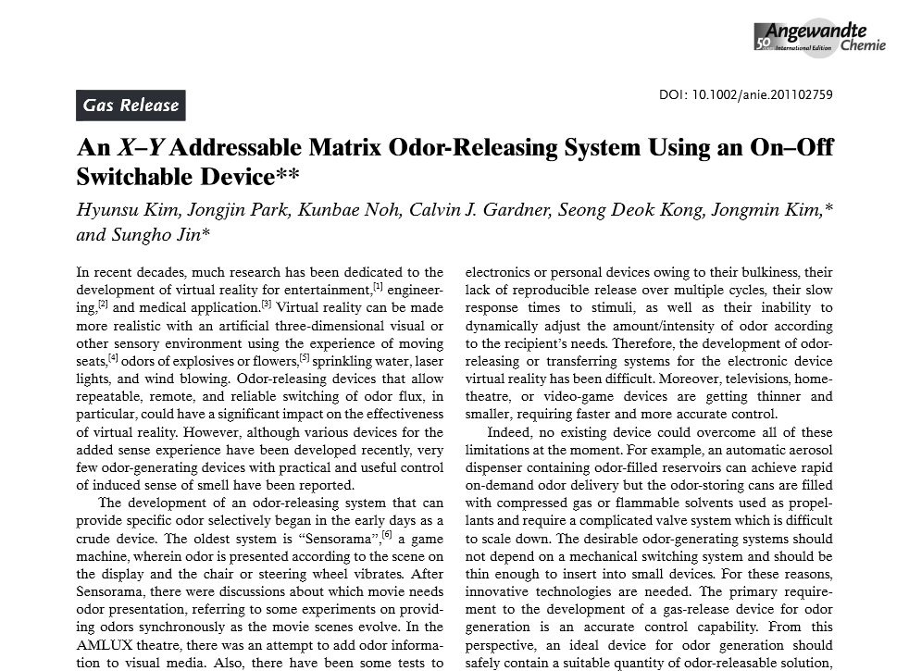
Smell – Smell-O-Vision

Slide 29
Smell – Smell-O-Vision

Slide 30
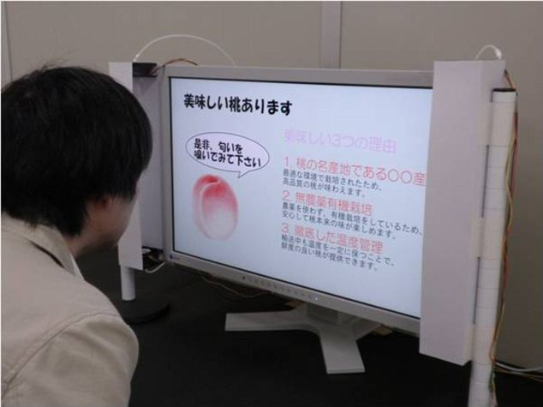
Smell – Smell-O-Vision

Slide 31
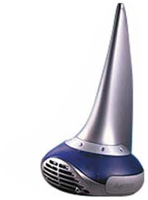
iSmell – Personal Scent Synthesizer
Connected to the computer via USB
128 ”primary odors” could be mixed to generate thousands of smells
Could be s(c)ent via e-mail
Never went into production...

Slide 32
Smell – olfactory encoding
Accurate mass yields elemental composition
Notes:
ethyl acetate, 2-isobutyl-3-methoxypyrazine and hydrogen sulfide

Slide 33
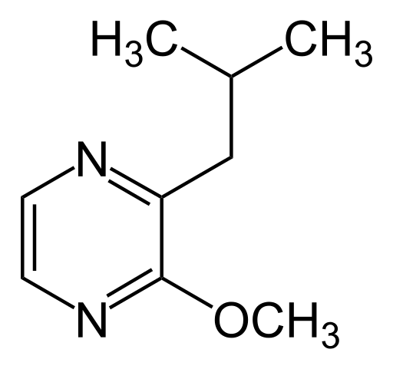
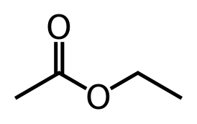
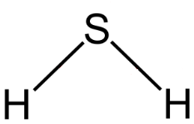
Smell – olfactory encoding
Accurate mass yields elemental composition
Each compound could be represented by a linear combination of ”primary odors”, e.g.
C₄₈H₈₂N₈O₁₀S = 3(C₄H₈O) + 4(C₉H₁₄N₂O) + 1(H₂S)
Notes:
ethyl acetate, 2-isobutyl-3-methoxypyrazine and hydrogen sulfide

Slide 34
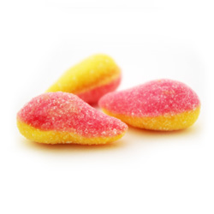
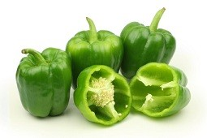
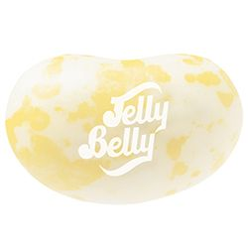
Smell – olfactory encoding
Accurate mass yields elemental composition
Each compound could be represented by a linear combination of ”primary odors”, e.g.
C₄₈H₈₂N₈O₁₀S = 3(C₄H₈O) + 4(C₉H₁₄N₂O) + 1(H₂S)
Notes:
ethyl acetate, 2-isobutyl-3-methoxypyrazine and hydrogen sulfide

Slide 35
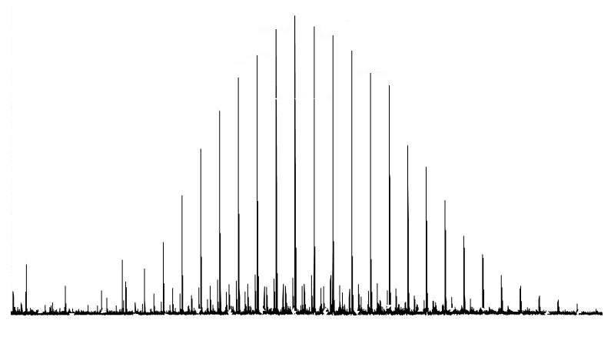
Smell – olfactory encoding
Accurate mass yields elemental composition
Each compound could be represented by a linear combination of ”primary odors”, e.g.
C₄₈H₈₂N₈O₁₀S = 3(C₄H₈O) + 4(C₉H₁₄N₂O) + 1(H₂S)
All members of the same polymer distribution would smell similar:
Notes:
If the repeating unit or monomer can be expressed in primary odors…

Slide 36
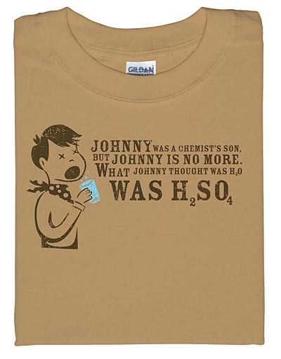
Taste (gustation)
Could work similar to smell
Possibly a health risk...
Notes:
2-Isobutyl-3-methoxypyrazine

Slide 37
What have we learned (if anything)?
3D displays/projectors may see increased use in teaching
3D printers can generate physical objects from any data
All MS data can be audialized – also ICR and Orbitrap FIDs

Slide 38
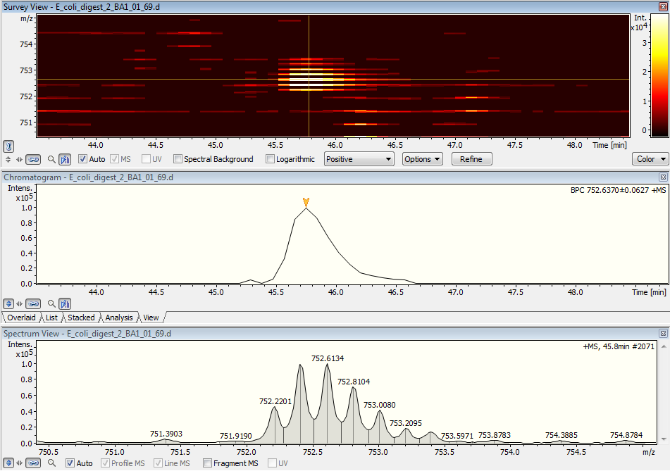
Answers to the exercises
monoisotopic mass 2844.75 Da
monoisotopic mass 3761.08 Da

Slide 39
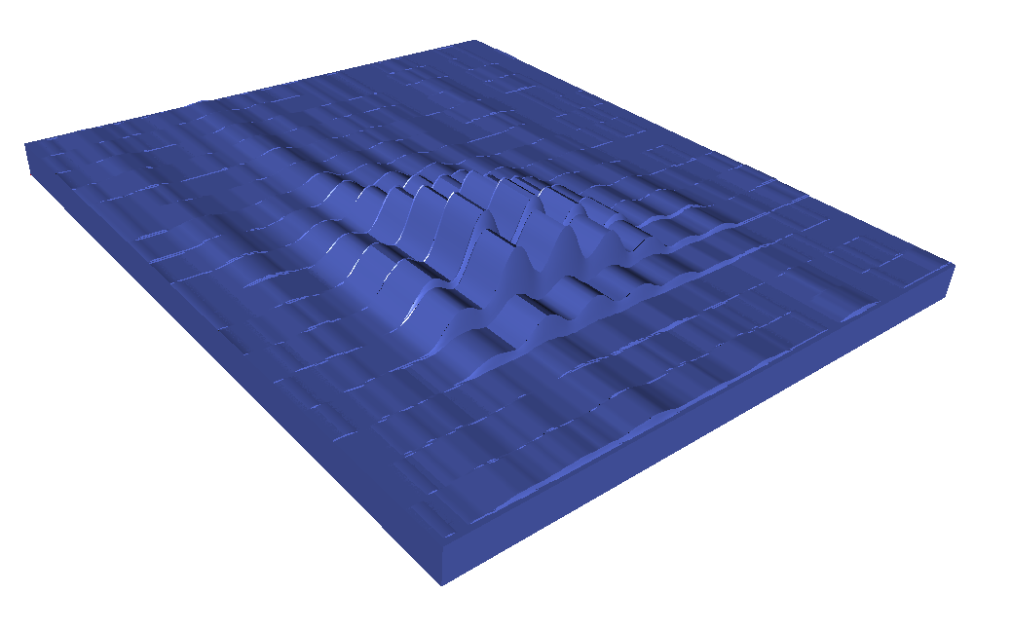
Answers to the exercises
monoisotopic mass 2844.75 Da
monoisotopic mass 3761.08 Da

